Slide 1
DAC
Digital to Analog Converter using an R2R ladder

Slide 2
DAC
A digital analogue converter converts a digital signal into an analogue signal.

Slide 3
Digital signal
Digital signals can only be on or off. They will show only on or off.
Example:
A microcontroller output pin toggling between 0 V and 3.3 V is a digital signal.

Slide 4
Analogue signals
Analogue signals can be any value within a range of values.

Slide 5
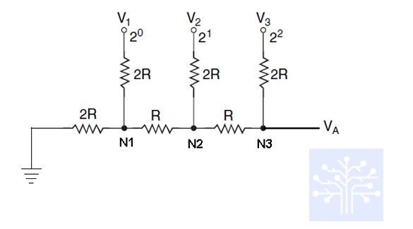
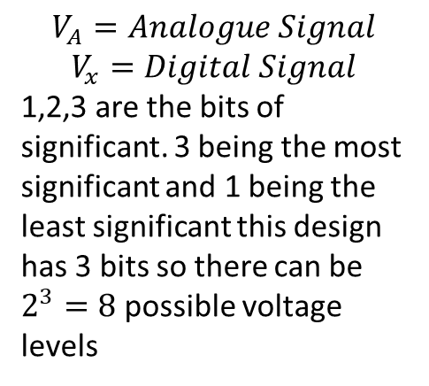
Design plan
$$V_{A}=Analogue Signal$$
$$V_{x}=Digital Signal$$
1,2,3 are the bits of significant. 3 being the most significant and 1 being the least significant this design has 3 bits so there can be $2^{3}=8$ possible voltage levels

Slide 6
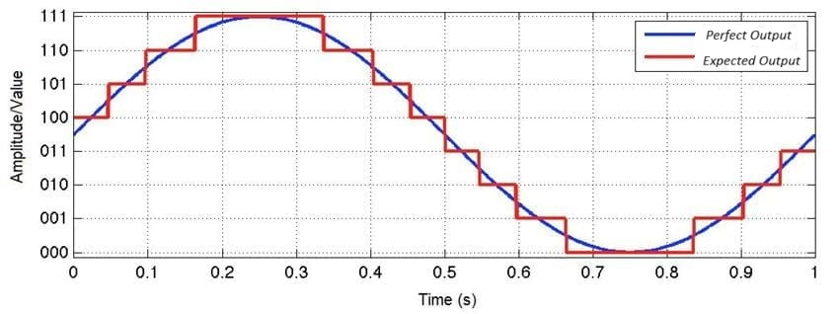
Expected output
The output will not be perfect because the signal will be discretised to 8 levels.

Slide 7
Voltage Levels
5V is max
0V is min
8 levels including 0V
Step is 5/7=0.7v

Slide 8
Simulation

Slide 9
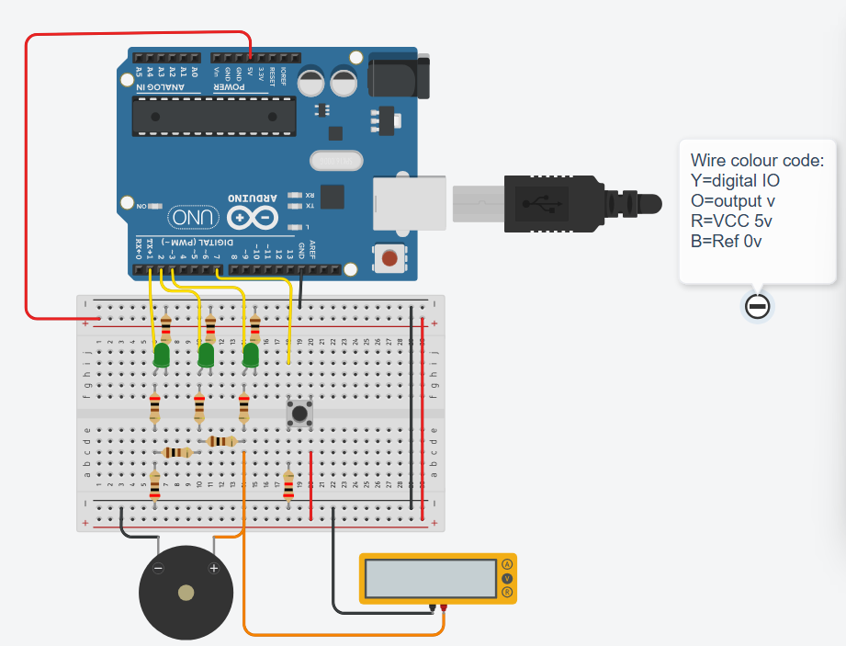
Final sim
Added a button to step through each level
added a speaker on output
See project on tinkercad
See code attached

Slide 10
Next steps
Create an ADC to convert audio to a digital signal
Use DAC to convert back into audio
Compare input and output audio

